Slide 1
Sound Perception
Maribeth Gandy
Notes:
Sources
http://www.nsa.gov/wwii/papers/start_of_digital_revolution.htm
http://www.digitalcentury.com/encyclo/update/audiohd.html
http://www.rci.rutgers.edu/%7Edmorton/sound_recording_overview.htm
http://www.digitalcentury.com/encyclo/update/audiohd.html
http://www.studio-sound.com/archive/nov99/celeb_computing.html
http://www.8trackheaven.com/early.html
http://teenmusic.about.com/library/weekly/aa012401a.htm
http://www.howstuffworks.com/cassette.htm
http://www.sharp.ca/consumer_minidisc.htm

Slide 2
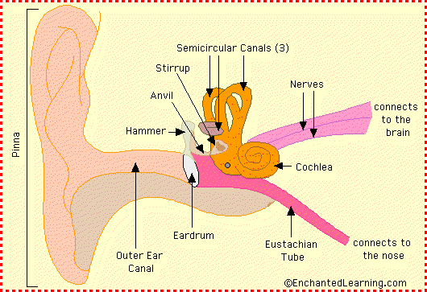
Anatomy of the Ear
Notes:
Sound is collected by the pinna (the visible part of the ear) and directed through the outer ear canal. The sound makes the eardrum vibrate, which in turn causes a series of three tiny bones (the hammer, the anvil, and the stirrup) in the middle ear to vibrate. The vibration is transferred to the snail-shaped cochlea in the inner ear; the cochlea is lined with sensitive hairs which trigger the generation of nerve signals that are sent to the brain.
Pinna or Auricles – amplify high frequencies, also important in localizing sounds. Some animals have muscular control of them, but we don’t
Eardrum or Tympanum
Three bones…ossicles…small muscles attached to them to dampen vibrations…protects inner ear from excessive vibration
Cochlea…means snail in latin
Outer, Middle, Inner Ear,
Eustachian tube, equalizes pressure on either side of the eardrum
Stirrup is smallest bone in human body 0.25 to 0.33 cm long
Ossicles are there for impedance matching. Outer, middle ear filled with air, inner with fluid…air easily compressible, water not.more force required to transmit sound in air than water. Move hand through air and water..different resistance…or impedance. So without ossicles vibrations would be poorly transmitted to the inner ear. First ossicles act as levers to increase force. Also concentrated on a smaller area, where they attach to cochlea (oval window) . Increases pressure by 20 – 25 times

Slide 3
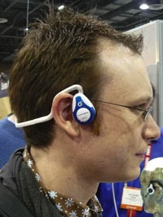
Anatomy of the Ear
Bone conduction
Why your recorded voice sounds “funny”
Bone phones
How do the cilia and neurons encode frequencies?
Can’t fire faster than ~1000Hz
Notes:
Bone conduction…no using middle ear…transmitted to inner by skull…low frequency (like chewing). This is why your voice sounds funny on a tape recorder ☺..you are hearing only air conducted sound.
Mysteries of how the ear encodes information to brain…still being studied.
(neurons cannot fire at rates exceeding 500- 1000Hz)
Modern theory combines these two ideas.

Slide 4
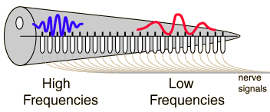
Anatomy of the Ear
Place Theory
Different parts of basilar membrane in cochlea respond to different frequencies
“tonotopic organization
Doesn’t seem to explain our large pitch resolution
Notes:
“Place theory” theory
Different parts of the cochlea respond to different frequencies and intensities, high in front, low in back. Draw diagram with spiral and starting at 20,000 going to 60 inside…”tonoptic organization”
“Frequency Matching” theory,
For low frequencies…frequency matching 250Hz, fibers firing at 250HZ…for higher freqs different neurons work together to encode
Freq…so while one neuron rests, the other fires, Volley principle
http://www.silcom.com/~aludwig/EARS.htm
..and binary…so how to encode amplitude?
For amplitude..increase in amplitude increases the number of nerves firing…so more impulses at same frequency

Slide 5
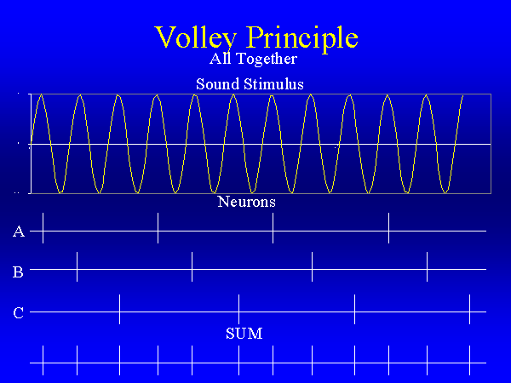
Anatomy of the Ear
Rate Theory or Frequency Matching
For lower frequencies perception depend on rate of neurons firing
At higher frequencies neurons may work together, “volley principle”
Notes:
“Frequency Matching” theory,
For low frequencies…frequency matching 250Hz, fibers firing at 250HZ…for higher freqs different neurons work together to encode
Freq…so while one neuron rests, the other fires, Volley principle.
http://www.silcom.com/~aludwig/EARS.htm
..and binary…so how to encode amplitude?
For amplitude..increase in amplitude increases the number of nerves firing…so more impulses at same frequency

Slide 6
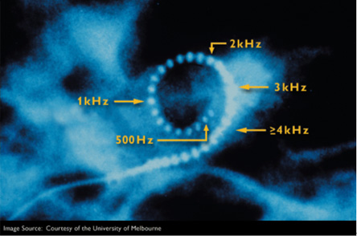
Anatomy of the Ear
But what about amplitude?
Nerve firings are binary
Encoded by number of nerves firing
Cochlear implants have recently provided more data
Notes:
In multi-channel cochlear implants, an electrode array is inserted in the cochlea so that different auditory nerve fibers can be stimulated at different places in the cochlea, thereby exploiting the place mechanism (Figure 3) for coding frequencies. Different electrodes are stimulated depending on the frequency of the signal. Electrodes near the base of the cochlea are stimulated with high frequency signals, while electrodes near the apex are stimulated with low frequency signals. Figure 3 is the X-ray image of cochlea that contains the intra-cochlear electrode array.
The signal processor is responsible for breaking the input signal into different frequency bands or channels and delivering the filtered signals to the appropriate electrodes. The main function of the signal processor is to decompose the input signal into its frequency components, much like a healthy cochlea analyzes the input signal into its frequency components. The designers of cochlear prosthesis are faced with the challenge of developing signal processing techniques that mimic the function of a healthy cochlea.
The cochlear implant is based on the idea that there are enough auditory nerve fibers left for stimulation in the vicinity of the electrodes. Once the nerve fibers are stimulated, they fire and propagate neural impulses to the brain through the auditory nerves. The brain interprets them as sounds. The perceived loudness of the sound may depend on the number of nerve fibers activated and their rates of firing. If a large number of nerve fibers is activated, then the sound is perceived as loud. Likewise, if a small number of nerve fibers is activated, then the sound is perceived as soft.
The number of fibers activated is a function of the amplitude of the stimulus current. The loudness of the sound can therefore be controlled by varying the amplitude of the stimulus current. The pitch on the other hand is related to the place in the cochlea that is being stimulated. Low pitch sensations are elicited when electrodes near the apex are stimulated, while high pitch sensations are elicited when electrodes near the base are stimulated. In summary, the implant can effectively transmit information to the brain about the loudness of the sound, which is a function of the amplitude of the stimulus current, and the pitch, which is a function of the place in the cochlea being stimulated.
http://helios.snu.ac.kr/sub_02_02-eng.html

Slide 7
Human Hearing
Psychoacoustics
how we perceive sound and extract meaningful data from acoustical signals
Important to many field of study like compression, machine hearing, speech recognition, and audio interfaces.
Human perception is quirky and complicated
Designed for self-defense
Language and music are byproducts?
Range of Human Hearing: 20 – 20KHz
Losing 1Hz a day after 15…
70 year old has range of 2-4KHz!

Slide 8
Human Hearing
Perception of intensity (loudness)
Ratio of loudest to softest sound 1billion : 1
Thus a logarithmic scale is preferable, Decibel
Named for Alexander Graham Bell
Compresses range of possible values into 0 to 160
Power doubles every 3 dB, intensity doubles, but not “loudness”
NB = 20 log PE / PR
NB = Number of Decibels
PE = Sound Pressure to express in Decibels
PR = Standard Reference Pressure
Notes:
Name for Alexander Graham Bell
NB = number of decibels
PE = sound pressure to be expressed in decibels
PR = standard reference pressure, 0.0002 dynes/cm2, 10^ - 12

Slide 9
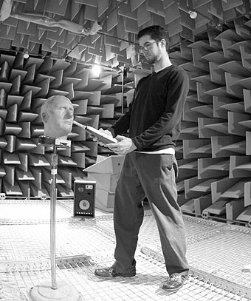
Human Hearing
Perception of intensity (loudness)
PR is average threshold of human hearing
Eardrum moves distance smaller than diameter of hydrogen atom
Lower sounds overwhelmed by blood flow in ears and molecules colliding with eardrum
Anechoic chamber
disorienting
Notes:
Because the floor, ceiling, and even the door of an anechoic chamber must be kept as free as possible of reflective surfaces, the working area is a small stage suspended in the very center of the room, accessed by a long walkway. The walkway and stage included handrails because people inside the chamber frequently become disoriented. Although we are not normally conscious of it, the tiny reverberations from sounds hitting the walls, floor, and ceiling of ordinary rooms are picked up by the inner ear and used to enhance our sense of balance. Without these cues, it’s harder to know which way is up.

Slide 10
Human Hearing
Perception of intensity (loudness)
20dB - whisper
60dB - normal conversation
120dB - rock concert
140dB - jet aircraft at takeoff…injury can occur
Dynamic range of orchestra 20-30dB in quiet parts and up to 110 dB
80+ dynamic range required
Vinyl - 50-70 dB
CD - 96dB
DVD - Audio 144 dB
Pop music very compressed
Human ear is most sensitive between 2-5 KHz
Resonant frequency of ear canal

Slide 11
Perception of Intensity
Fletcher-Munson curves
Phons
measure of loudness
Subjects listen to 1KHz tone and are told to tune tones of other frequencies to that same loudness
“loudness” setting on stereo
Boosting frequencies based on perception
Notes:
Subject listen to 1000 HZ tone and are told to tune tones of other frequencies to that same loudness…
Phons a measure of loudness
Loudness setting on stereo
100,200,400,800,1600,3200,6400
f

Slide 12
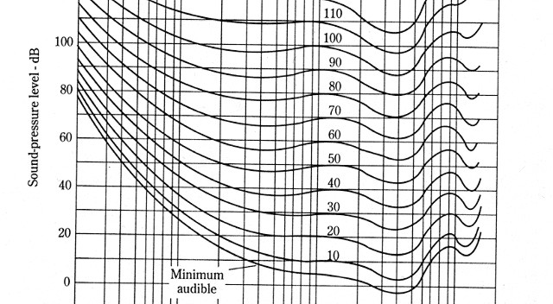

Perception of Intensity
Notes:
Subject listen to 1000 HZ tone and are told to tune tones of other frequencies to that same loudness…
Phons a measure of loudness
Loudness setting on stereo
100,200,400,800,1600,3200,6400

Slide 13
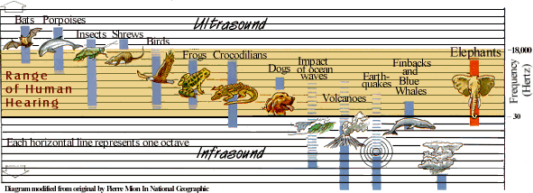
Perception of Frequency
Rage of Audible Sound Frequencies for Various Species
Notes:
Goldfish perception ☺ Play sound, shock fish, respiration slows. Eventually, play sound, breathing slows. Then play new sounds, see if breathing slows down. Conclusion goldfish perceive sounds the way we do.
Elephant 17Hz - 10KHz
Human 20Hz - 20KHz
Horse 55Hz - 33.5KHz
Monkey 110Hz - 45KHz
Mouse 1KHz - 90KHz
Bat 3KHz - 120KHz

Slide 14
Perception of Frequency
Frequency Discrimination
How small of a frequency change can humans detect?
<1000Hz = 3Hz
1000Hz>X<10,000Hz = small fraction of frequency
Weber Fraction
Change in frequency / frequency = .004
40Hz / 10KHz = .004
So, perception worsens as frequency increases
But also dependent on intensity of sound
Notes:
So at 10,000 Hz, a 40Hz change is required for the change to be perceived
X / 10,000 = 0.004
As intensity is decreased it becomes more difficult to discriminate

Slide 15

Perception of Frequency
500 – 501
500 – 502
500 – 503
500 – 504
10k – 10,005
10k – 10,010
10k – 10,030
10k – 10,040
10k – 10,080

Slide 16
Perception of Frequency
Pitch versus frequency
Relationship between perceived pitch and actual frequency is not linear
For freq less than 1000, pitch rises more quickly than freq
Pitch of 500 is frequency of 100,
For freq greater than 1000, pitch rises more slowly than frequency
Pitch of 2000, frequency of 3000
Pitch of 3000, frequency of 10000
Notes:
Same as intensity test…subject are played a 1000 Hz tone and are told to tune a sound to ½ that 1/3 that 2X etc.
Draw graph

Slide 17
Perception of Frequency
Pitch and Intensity
Two tones of slightly different frequencies were presented and the observer adjusted the intensity of one tone until both tones were perceived as equal in pitch (Stevens 1935)
When intensity is increased the pitch of high tones increases
Pitch of low tones decreases
For frequencies in the middle range the effect is minimal (1000 – 2000 Hz)
Notes:
Classic study in 1935, Stevens effect of intensity on pitch of tones for 11 frequencies ranging from 150 to 12000 Hz
Two tones of slightly different frequencies were presented and the observer adjusted the intensity of one tone until both tones were perceived as equal in pitch

Slide 18

Timbre
A sound’s distinctive tonal quality produced by the number and intensity of harmonics (overtones) it produces
Timbre gives an instrument its distinctive sound
Guitar and piano produce many harmonics so tones are fuller and richer
Flute has few harmonics which give a clear pure tone

Slide 19
Effect of Multiple Tones
Duration of tones important
Can recognize and differentiate better the longer the duration
Less than 250 msec will lose tonal quality and will sound like click
Loudness also affected by duration up to about 0.2 seconds
Loudness grows with duration
Muscles in ear will provide 20dB of protection after 150ms
Notes:
Less than 250 msec..will lose tonal quality and will sound like click

Slide 20
Effect of Multiple Tones
Masking
Perception of sound depends on its frequency and intensity but on the other sounds present at the time.
Two tones, close in frequency, with one of a greater intensity
Intense tone will reduce or eliminate the perception of the softer tone. “drowning out”
The closer the masking and test tone, the greater the masking effect
The more intense the masking tone the greater the masking effect on broader range of frequencies
If the test tone frequency is greater than the masking tone, the effect is increased.

Slide 21
Effect of Multiple Tones
Forward and backward masking
Masking can occur when the tones are not simultaneous
Interaural Masking
Intense sound in one ear can mask weaker in other ear
http://webpages.mcgill.ca/staff/Group2/abregm1/web/downloadstoc.htm#22
Temporary loss of hearing sensitivity
Greater for high frequencies
Permanent Threshold Shift
e.g. industrial settings
Notes:
http://www.psych.mcgill.ca/labs/auditory/demo22.html -> http://webpages.mcgill.ca/staff/Group2/abregm1/web/downloadstoc.htm#22
Backward masking: a test tone, interval of 50 msec, more intense masking tone.
Intense sound in one ear can mask weaker in other ear.
Permanent loss usually in industrial environments

Slide 22
Effect of Multiple Tones
Auditory Adaptation
Loudness of a continuous sound seems to diminish over time.
e.g. car stereo
The ability to hear steady sounds diminishes over time.
Opposite is also true, a silent environment will increase sensitivity
Not unlike pupil dilation
Notes:
Me with the car radio
3 minutes with 80dB sound….sounds like 60 dB
Again…this is survival instinct
Like your eyes dilating

Slide 23
Subjective Attributes of Sound
Volume
Size or voluminous-ness of a tone. Certain tones seem to take up more space than others
Density
Compactness or tightness of sound
Higher frequencies are more “dense”
Inversely related to intensity
Notes:
In studies people can do these classifications

Slide 24
Subjective Attributes of Sound
Consonance and Dissonance
Consonant tones sound pleasant together and blend well together
Dissonant tones sound discordant or harsh together
It is thought that dissonance occurs when the upper harmonics of the two fundamentals are close in frequency
And consonance occurs when the harmonics are different enough that they are heard as two sounds or they reinforce each other
Culture and customs have a role in this
220Hz
220Hz w/ organ-esque harmonics
Two dissonant tones
Three dissonant tones
Notes:
http://www.musicmasterworks.com/ConsonanceComplication/TheComplicationWithConsonance.htm

Slide 25
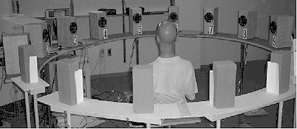
The Role of Two Ears
Need two ears for perceiving distance and direction
Monoaural (one ear) cues
Binaural (two ear) cues
Ability to localize sounds is crucial to human and animal hearing
Notes:
http://www.hearingresearch.org/

Slide 26
The Role of Two Ears
Dichotic listening
Different or competing stimulation delivered to each ear
Right ear and left hemisphere are dominant for processing linguistic material. (sequential analytic processing)
Also true for “speech like sounds” such as reversed speech
Reverse is true for music, nonverbal sounds, nonverbal vocalizations. (holistic integrative processing)
But music professionals use the left brain for this…
Notes:
Dichotic: alphanumeric strings read into each ear through headphones…more digits that were read into right ear (and left auditory cortex) were reported correctly…right ear and left hemisphere are dominant for processing linguistic material.
Also true for “speech like sounds” like reversed speech
Reverse is true for music, memory of melodies, chords and notes from instruments, and pure tones.
And for nonverbal sounds (phone ringing, dog barking, clock ticking)
And for nonverbal vocalizations (cry, sigh, and laugh)
But the right and left dominance is not because brain specifically designed for verbal on the left and music on the right, instead the different hemispheres are specialized for a type of processing or analysis. Left being good for sequential, piecemeal, and analytical processing. Right is good and an integrative, holistic approach. Which happens to apply to speech and to music.
Music professionals recognize melodies better with right ear, probably because they use different listening strategies.

Slide 27
Perception of Space
Monaural cues used for distance and crude localization
The louder the sound the closer the object
As the loudness changes so does its perceived location
Monaural direction sensed via head movements if the sound is repetitive and long lasting
Notes:
an approaching sound seems to change more than a receding one. And this asymmetry increases with intensity.
http://www.physics.odu.edu/~hyde/chw.htm
This is a recording of the Carillon bells at Brigham Young University. The recording is made from a car as it drives by. The speed of the car was 25 mph. The bells were playing the first four measures of the hymn, "Come, Come Ye Saints". The car passed by the bells at the end of the second measure. This recording is contained in the sound file, BELLS.WAV. I also made a shorter version of the recording by removing space between strikes of the bell. This shorter version is contained in the sound file, BELLS2.WAV . http://ccp14.minerals.csiro.au/ccp/web-mirrors/isotropy/~stokesh/bells.html
The distance asymmetry makes sense biologically
Monaural cues for direction…the differing loudness can be used to figure out direction

Slide 28
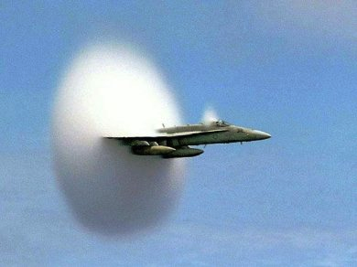

Perception of Space
Doppler Shift
Distance cue caused by pitch shift of a moving sound source
Waves do not share a common center and therefore get bunched up in the front of the moving source.
Pitch increases as object approaches, decreases as it passes by.
Sonic Boom, when speed of sound source exceeds speed of sound
Notes:
an approaching sound seems to change more than a receding one. And this asymmetry increases with intensity.
http://www.physics.odu.edu/~hyde/chw.htm
This is a recording of the Carillon bells at Brigham Young University. The recording is made from a car as it drives by. The speed of the car was 25 mph. The bells were playing the first four measures of the hymn, "Come, Come Ye Saints". The car passed by the bells at the end of the second measure. This recording is contained in the sound file, BELLS.WAV. I also made a shorter version of the recording by removing space between strikes of the bell. This shorter version is contained in the sound file, BELLS2.WAV . http://ccp14.minerals.csiro.au/ccp/web-mirrors/isotropy/~stokesh/bells.html
The distance asymmetry makes sense biologically
Monaural cues for direction…the differing loudness can be used to figure out direction

Slide 29
Perception of Space
Binaural cues important for direction perception
Time Differences
Interaural time difference (best for low freq)
Precedence effect
Filtering out of reflections and echoes, humans don’t even hear echoes earlier than 35 msec
Phase differences
For frequencies <1000Hz
Interaural intensity difference (best for high freq)
Shadowing, object must be large in relation to wavelength, <1000 Hz
Same tone in both ears, but of differing intensity, will be heard as coming from the direction of the more intense tone.
Notes:
Two ears give two different “views” of a single sound
Difference can be as little as .0001 of a second
Phase differences… wavelength large in relation to head and head produces diffraction patterns
Trick to catch people feigning deafness in 1900s
Time diff best for locatliing low freq….intensity best for high freq.

Slide 30
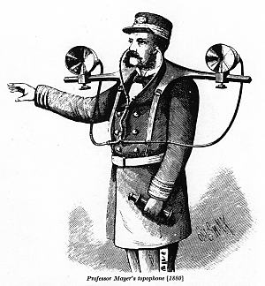
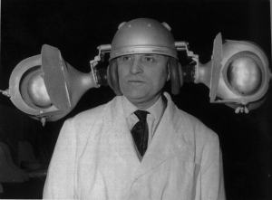
Perception of Space
Perception in vertical plane
Median plane sounds are ambiguous
Head turning resolves confusion
Pinna also aid in localization
Human Echolocation
Gauge distance based on echo
Cane used by people with low vision
Notes:
Big ears make for better localization ☺
Molds filling in the pinna caused for reduction in localization accuracy
But study also showed that this can be relearned somehow and accuracy returns
Move around pinna and notice change in sound…deeper and fuller if pulled forward…back flat…catch less sound waves and voice sounds thinner and higher in pitch….
http://www.dself.dsl.pipex.com/MUSEUM/COMMS/ear/ear.htm
This image has been reproduced many times in the past, It was devised to assist navigation in fog. I have no information on its success or otherwise.
Image from Scientific American 1880.
This remarkable device was invented by Frenchman Jean Auscher as an acoustic navigation device in case of radar failure on small vessels. Shown at the 1960 Brussels Inventor's Fair, and, one suspects, nowhere else ever again.
Hard of hearing people cup hand around ear.
Echolocation: study with people listening to recorded audio of experimenter approaching an object. They were able to tell.
Tapping cane for the blind. Reflections also sound tells about surface.
Sighted people with blind folds are not very good at this, But blind people can figure out distance and size info based on self-produced sounds..also texture.
However, non-blind can also do stuff like this…estimating length of rod based on sound in makes when it hits the ground. And shape based on sound when object struck with hammer (circular, triangular, rectangular)
We also use sounds like…the frequency change as a container becomes filled with water.
clicker project

Slide 31
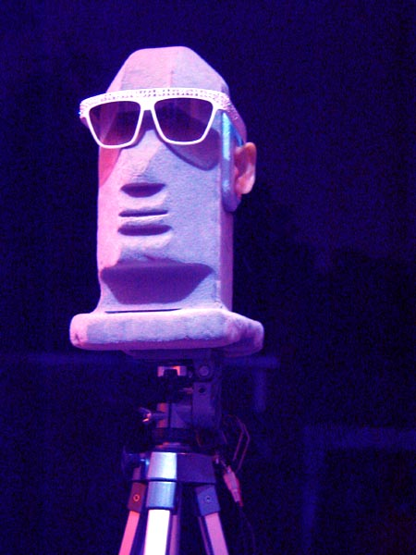
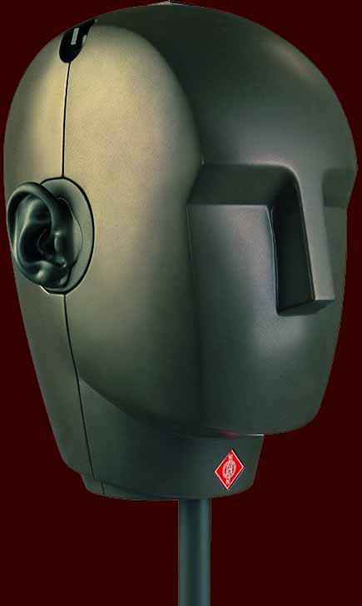
Perception of Space
Binaural Recordings http://www.freesound.org
Notes:
http://freesound.iua.upf.edu

Slide 32
Transients and Human Hearing
Steady state
Remains constant over time
Periodic or almost constant excitation pattern
Fourier Analysis will work nicely
Transient
Changes quickly over time
Changes of state from one constant pattern to another
Frequency oriented methods do not work well
What are some examples of a transient part of a sound?
Notes:
examples of transient and steady state sounds?

Slide 33
Transients and Human Hearing
Watching a picture versus watching a movie
Classical study of instrument identification
Without the transient a instrument sound is difficult to identify
Two instrument sounds can be merged without transient and second sound is still identified as being part of first.
Notes:
Look at two of the flute sound files in soundforge…the 1 note C4

Slide 34
Transients and Human Hearing
The startle and orientation reflexes triggered by transients
Easier to localize due to interaural time difference
Transients contain more interesting information
High frequencies generated by high energy
Inharmonic content generated by initial excitation
More different types of transients than quasi-periodic sounds

Slide 35
Perception of Speech
Vowels are steady state, consonants are transients
Vowels are pitches, consonants are noisy and unpitched
Speech perception impressive considering, 180 wpm, dialects, accents, background noises, distortion caused by telephones etc.
Speech produced by vocal cords producing sound waves that vibrate air in the cavities of the mouth, throat, and nose

Slide 36
Perception of Speech
6500 Hz upper range of speech
Vowels, <3000Hz, many <1000Hz
Consonants, 1000Hz< >5000Hz
Intensity range of approximately 70dB
Phonemes, smallest unit of speech
Silence cues
“light housekeeper”, “lighthouse keeper”
Accent cues
“invalid”
Notes:
Light housekeeper, lighthouse keeper,Spiderman, spider man
Invalid

Slide 37
Perception of Speech
Distortion
Frequency cutoff
Missing sounds
Context is key
Phonemic restoration effect
Words are more accurately perceived when they are heard within the context of other words
All freq
>2116Hz
<2116Hz
<160Hz
>10KHz
Notes:
Freq study, 1947, sounds with freq above or below 1900Hz thrown away…speech still intelligible…crucial info not confined to any frequency range.Consonants high freq, vowels low…so neither band is totally required.
All freq, >2126, <2126, <160
We fill in the gaps when parts of word are missing…via anticipations and expectations…context
Phonemic restoration effect…..study in 1970…”It was found that the ()eel was on the orange”…cough inserted at parens…
People said they heard “p” ….people had poor perception of when cough occurred…but this was not true for silence
Depending on sentence…also “eel was on the shoe”, the “eel was on the axle”
http://www.acsu.buffalo.edu/~bmb/Courses/Old-Courses/PSY341-Fa2003/Exercises/Phon-rest/phon-rest.html
Misunderstanding lyrics of songs..william safire, new york times….”Gladly, the Cross I’d Bear”…”Gladly, the cross-eyed bear”
Speech blanking..can test with a radio

Slide 38
Perception of Speech
Distortion
Speech blanking
When 50% of conversation blanked (9 blanks per second), only 15% of words lost
Word segmentation, based on familiarity with language and speaker
Speech contains redundancy, operates under adverse conditions…
Speech recognition is hard
Notes:
Freq study, 1947, sounds with freq above or below 1900Hz thrown away…speech still intelligible…crucial info not confined to any frequency range.Consonants high freq, vowels low…so neither band is totally required.
All freq, >2126, <2126, <160
We fill in the gaps when parts of word are missing…via anticipations and expectations…context
Phonemic restoration effect…..study in 1970…”It was found that the ()eel was on the orange”…cough inserted at parens…
People said they heard “p” ….people had poor perception of when cough occurred…but this was not true for silence
Depending on sentence…also “eel was on the shoe”, the “eel was on the axle”
Example of speech interface for HCI class
Misunderstanding lyrics of songs..william safire, new york times….”Gladly, the Cross I’d Bear”…”Gladly, the cross-eyed bear”
Speech blanking..can test with a radio

Slide 39

Audiovisual integration
Acoustic speech is usually coupled with visual information such as lip and face movement
McGurk Effect
Auditory and visual information act together to affect what is heard.
First study, auditory signal in direct conflict with visual signal
Notes:
People could lip read ga ga reasonably accurately…
Video of woman saying “ba ba”, audio track of woman saying “ga ga”.
Could be identified by subjects when just video or just audio displayed
But when heard together subjects heard “da da”
http://www.media.uio.no/personer/arntm/McGurk_english.html
So heard a syllable that wasn’t there…and also didn’t notice that there was a disparity in video and audio

Slide 40
Audio Visual Integration
This effect persists even when disparity is obvious
Man in video, woman’s voice on soundtrack
“da da” still heard
Evidence of vocal effort is also influential
Man in video speaks with effort (indicating loud sound), but soundtrack was of low intensity
Subjects asked to judge loudness, only on sound, but sound judged to be louder when matched with video showing effort.
The more effort shown the louder the sound was judged to be
So, when visuals are available we use them to resolve ambiguity
Notes:
Visuals obviously not necessary…blind people do just fine…but Good in noisy environments..especially when trying to differentiate speech signals

Slide 41
Auditory Scene Analysis
In natural environments our sound events are not unitary
We are constantly assaulted with overlapping sounds from various sources
Speech
Music
Background noise
Yet, we are able to break down auditory scene into individual elements
Notes:
Unitary…we hear a set of tones and recognize a melody or hear some phonemes and perceive speech or a single tone and localize it.

Slide 42
Auditory Streams
Groups of sounds that appear to come from the same source, because they share common characteristics are perceived as a distinct stream.
Pitch, loudness, timbre
This is also true for speech,
Accent, phrasing, intonations
Notes:
And these pitch and loudness values will be effected by the location they come from

Slide 43
Auditory Streams
Stream Segregation (Bregman Lab Demo)
Two tunes, in same pitch range, with individual notes alternated in sequence.
Neither is recognizable
But if pitch is changed slightly they will become perceptually distinct.
This ability to segregate increases with difference in pitch.
Or if duration of notes for one stream is increased, they will become distinct
Other factors are focus of attention, and experience
Physician listening to brain signals
Monaural listeners are worse at segregating streams
Localization important
Notes:
http://webpages.mcgill.ca/staff/Group2/abregm1/web/downloadstoc.htm#01
20 seconds into audio file for demo

